Slide 1
Assignment 2: Search and Optimization Team: CS22B043, CS22B050
Environment Setup
Frozen Lake: The Frozen Lake environment simulates a grid-world where an agent must navigate across a frozen surface to reach a goal without falling into holes. Due to the slippery surface, actions may not always move the agent in the intended direction.
Used in Branch & Bound ,Iterative Deepening A*
The Traveling Salesman : a classic combinatorial optimization problem where a salesman must visit N cities exactly once and return to the starting city, covering the shortest possible distance. TSP is NP-hard — no known polynomial-time solution.
Used in Hill Climbing,Simulated Annealing

Slide 2
Heuristic
Environment: Frozen Lake Branch & Bound Heuristic: BnB systematically explores the search space by pruning paths that exceed the current best cost. It does not rely on domain knowledge or future cost estimation hence, no heuristic is used. It’s purely cost-driven and exhaustive, but efficient with pruning.
No heuristic
Iterative Deepening A* Heuristic: The Frozen Lake grid is a 2D grid, and movement is restricted to up, down, left, right. So, Manhattan distance
Manhattan distance
Environment : TSP Hill Climbing : In TSP, we aim to minimize the path cost of a complete tour. Hill climbing works by checking neighboring solutions (swapping cities) and choosing the best. So, the total path distance acts as a direct measure of solution quality
Total Distance
Simulated Annealing : Similar to Hill Climbing, we minimize total tour cost. But SA adds a probabilistic jump to worse solutions (based on a temperature schedule) to escape local optima. So the heuristic includes total distance, and the acceptance probability is influenced by randomness. This makes the search more exploratory.
Total Distance + Randomness

Slide 3
BnB and A*
Branch & Bound
Iterative Deepening A*

Slide 4
Hill Climbing

Slide 5
Simulated Annealing

Slide 6
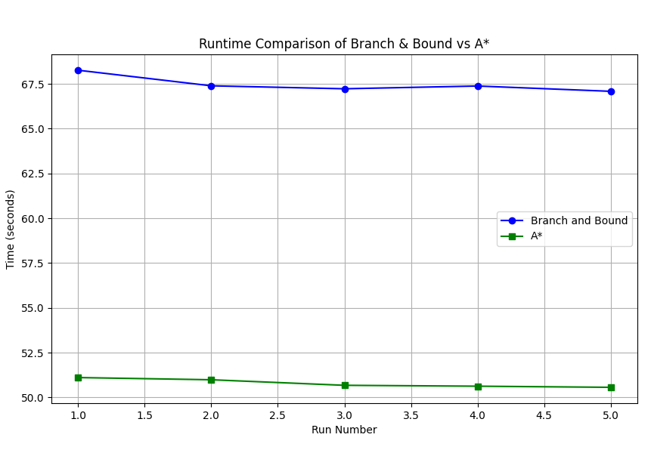
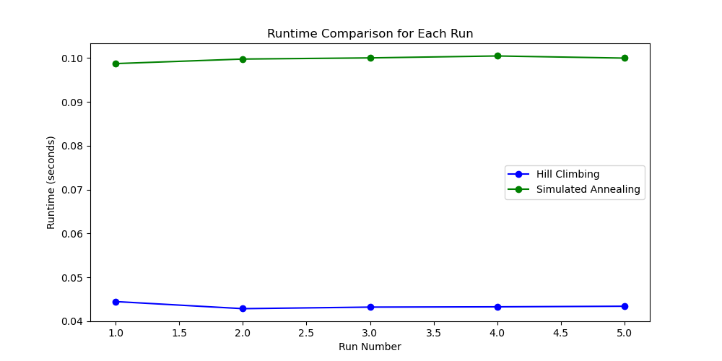
Runtime Comparisons
Bnb and A* HC and SA

